Slide 1
A Machine learning deployed model to predict Flight Fare using decision tree cost functions to improve test data accuracy

Slide 2
Project Members:
Yeshraj Maganti-1144105
Subash Chandra Bose Kondru-1140025
Amarnath Pohanerkar-1140818
Sri Lakshmi Srinivas Gandham-1120106

Slide 3
Subject: Cloud Computing Project
AWS Services:
EC2 Instances
Security Group
Amazon Sage Maker
S3 bucket
Tools:
Putty Generator
Putty
WinSCP

Slide 4
Abstract: -
Flight transport system is playing vital role for every individual life when emergency takes place to travel from one place to another. The travelling of customers from source to destination at any time and they will come to know the chances of getting less prices of flight fare to plan their journey in a most economical where the charges are dynamic. So mainly the flight fare is the main challenging task to every customer will know about cost of the journey on priority basis. The machine learning model will suggest the best buy price of the flight ticket when to buy a ticket. The hyper parameters tuning will reduce the over-fitting of data and improves the accuracy on training data is with highest accuracy and on test data was improved as well on the prediction model. The data was collected from 16 routes among which 4 routes were used for analysis.

Slide 5
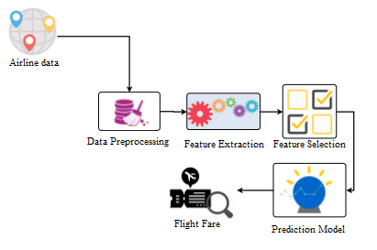
Proposed System

Slide 6
Security –
Security group
Public and private keys
Scalability –
You can add more data.
Hypervisor tuning provides more accuracy than decision tree.

Slide 7
Thank you

